Slide 1
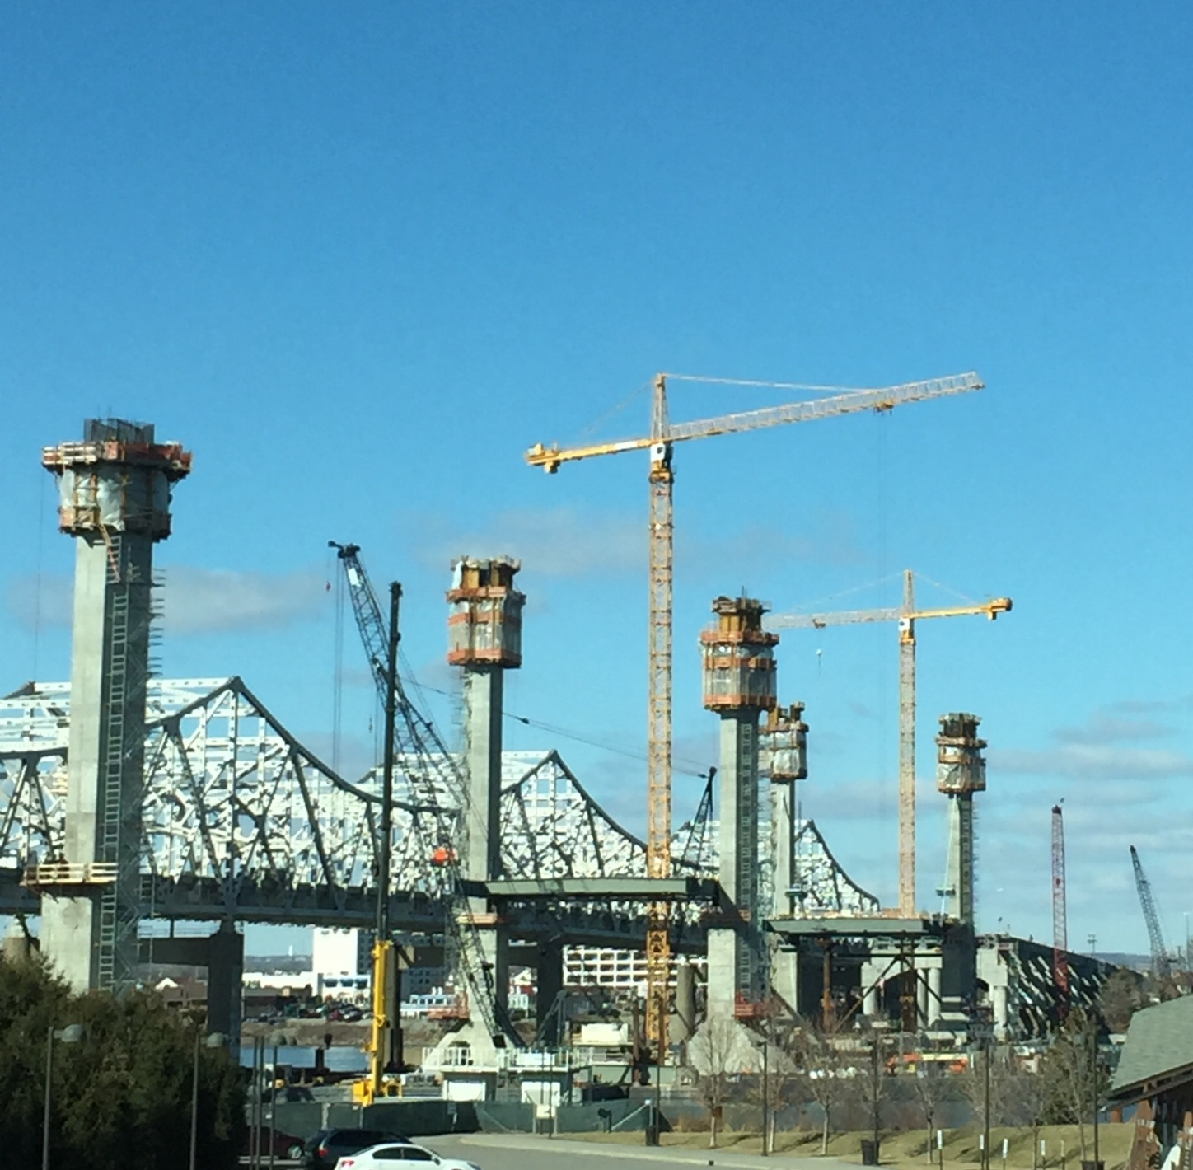
CHANGE ORDER Minor annoyances for Bob
Once you start change order get reviewed and processed!

Slide 2
Change Order Explanations
Brief but explain the problem and solution.
If supplemental item need reference how price obtained (ave. bid cost, breakdown, comparision, etc)
Mention item of work in explanation. Do not put simply “this item” Also run Spell Check if lot of words or only a few!
example:
[8001] [8002] GUARDRAIL-Material Only these items are for invoice paid for remainder of guardrail quantities on grade contract and will be installed as an "install only" price on the surfacing contract. This will allow for the grade contract to be completed.

Slide 3
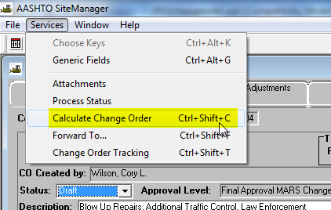
Change Order Explanations Continued
Use Mixed Case NO YELLING
Spell Check most Engineers cannot spel ;-)
If Federal funded (FD52) and keeping unused items for maintenance need to get NON PARTICIPATING funding category setup!
Before sending for review and after any changes run Calculate from Services on Header tab

Slide 4
Change Order Explanations Continued
Contract may have Multiple funding lines (PO2 Line Number) be aware each is a separate pot of money. When you write a zero sum change but one of PO2 lines will be out of money, it still need to get that fund increased.
PLEASE PLEASE after notice of reviews completed PLEASE get signatures from Section and CDE and put in PEND status and apply PEND approval at Section Level. Change order cannot be proceed if PEND approval not applied!
FHWA review for “PoDI” Project of Division Interest (FHWA)contracts.
In supplemental description & explanation if inches use IN not “, if feet use LF not ‘. For example 20 IN
Do use ALL CAPS for supplemental Description. Item Description in database is all CAPS and looks better.

Slide 5
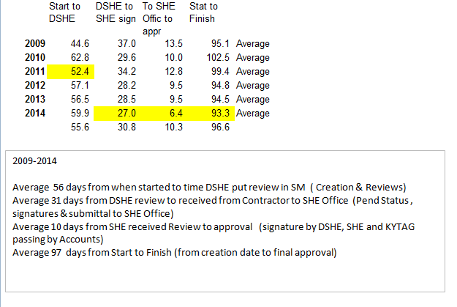
CHARGE ORDER
Once you start change order get reviewed and processed!

Slide 6
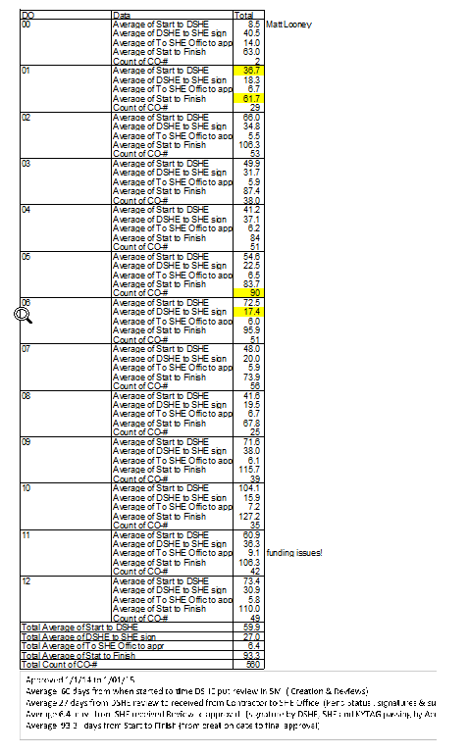
Brownie, you're doing a heckuva job
D5 loves to write Change Orders
D6 over acheivers

